Slide 1
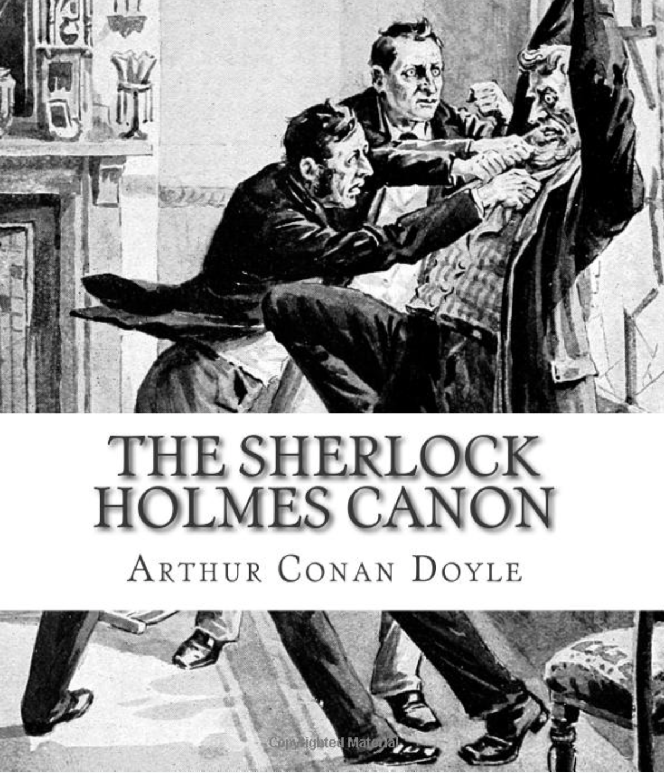
ANNE JAMISON | UNIVERSITY OF UTAH | FANFICTION AND ADAPTATION
What is canon and where did it come from?
01

Slide 2
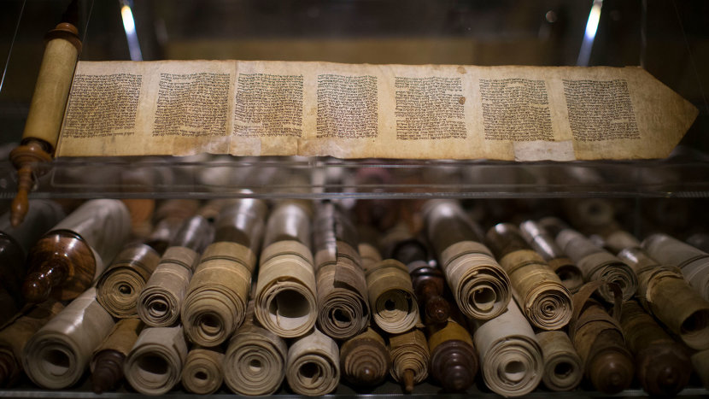
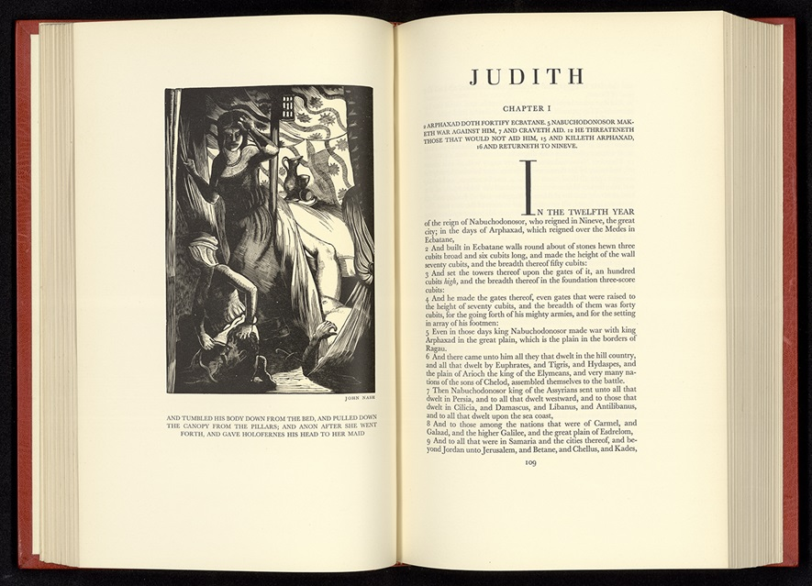
ANNE JAMISON | UNIVERSITY OF UTAH | FANFICTION AND ADAPTATION
In the beginning, there was…the Bible.
Canon comes from Biblical studies, and refers to the group of texts understood as authoritative.
Apocrypha refers to disputed books or texts not included in canon.
NOTE: religions/sects historically disagree.
See also Deuterocanonical=Old Testament texts considered canon by some traditions (typically Catholic & Orthodox) but not others (Protestants)
Early Biblical Old Testament Scrolls (Getty)
02
Illustration to the 1688edition of Paradise Lost
Book of Judith, Apocrypha (Cresset Press, 1929)

Slide 3
ANNE JAMISON | UNIVERSITY OF UTAH | FANFICTION AND ADAPTATION
What else does canon mean?
Besides the fannish meaning, which we’ll get to…
The accepted authentic works of an author
A group or list of texts understood as sanctioned or authoritative, like “great books” or, as a course at Oxford used to be known, “Greats.” This sense inspires what are known as “canon wars” which historically (here) grew out of questions about who belonged on the list: anyone besides “dead white guys”? *
An accepted rule or norm or a group of them
Interestingly, a musical form, like the famous Tallis Canon
*When I was in grad school in the 1990s, we campaigned—unsuccessfully--to have a few women added to the list of books all undergrads had to read to get a Comparative Literature degree..
03

Slide 4
ANNE JAMISON | UNIVERSITY OF UTAH | FANFICTION AND ADAPTATION
Who decides?
Note the emphasis on “accepted” and “authoritative” without any specifics on just who is doing the accepting and who has the authority. Consider how the word excludes as well as includes.
In fact, canons of all kinds (except possibly the contrapuntal musical composition) are historically disputed.
03

Slide 5
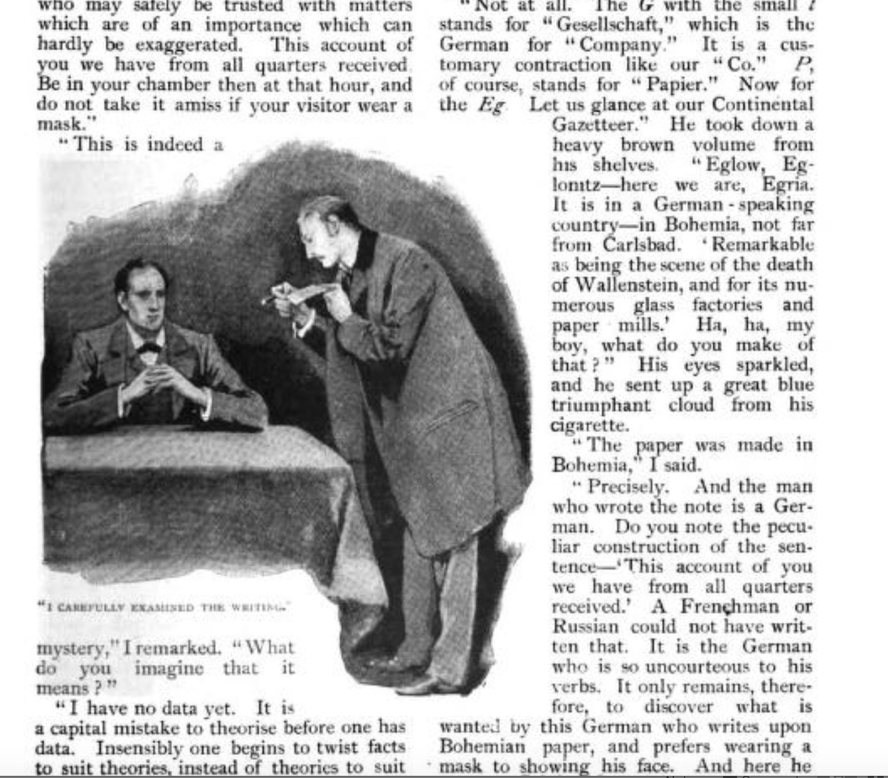
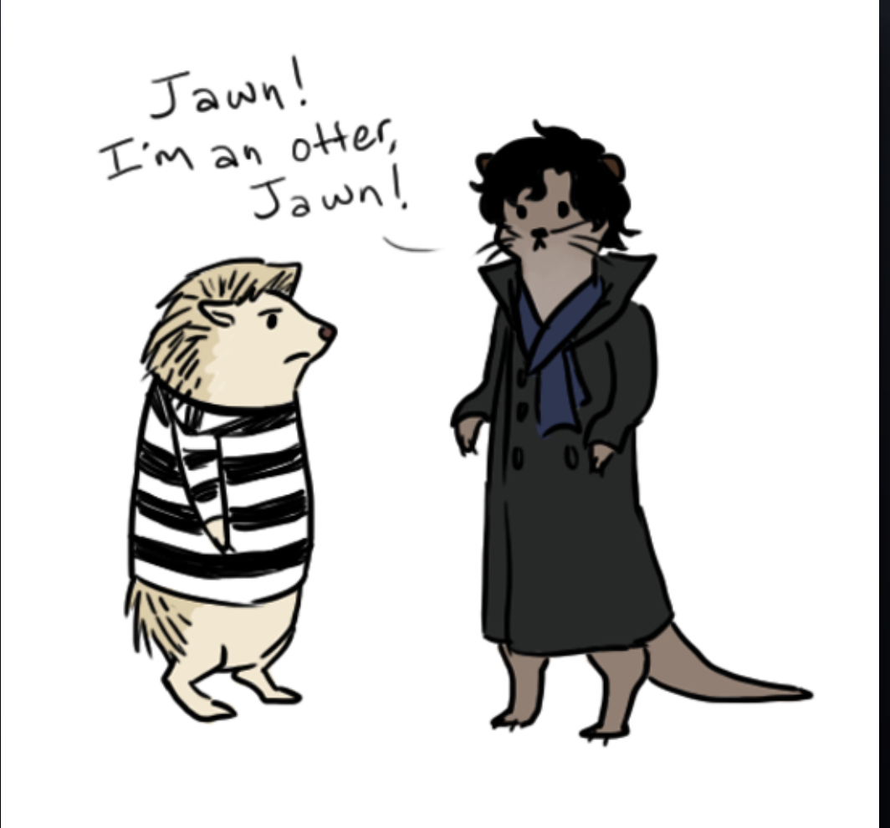
ANNE JAMISON | UNIVERSITY OF UTAH | FANFICTION AND ADAPTATION
In fannish terms, “canon” is whatever forms part of an “official” story, world, or universe: what is “really there” and what “really happened”
Important for sources with multiple media and/or adaptations, tie-ins, fan works, etc. (i.e. Star Wars).
Sometimes it’s clear: Otterlock isn’t canon.
Sometimes it’s not: Are tie-in novels canon?
Sometimes official canon is wrong: HAN SHOT FIRST AND ONLY GEORGE LUCAS THINKS HE DIDN’T
Original Holmes with
Original illustration
Canon
Otterlock is not canon
Not canon (Otterlock art by fullxmetalxgir

Slide 6
ANNE JAMISON | UNIVERSITY OF UTAH | FANFICTION AND ADAPTATION
So who decides what is canon?
Fan sources will often say that “canon” is what fans as a community agrees is canon.
Rightsholders and authors claim they decide what is canon.
”Fanon” is widely accepted by fans as part of lore but not asserted to be part of “official” canon (i.e. Leather Pants Draco)
“Headcanon” is what you as an individual accept as true about a source
From Fanlore, the fandom encyclopedia by the Organization for Transformative Works
Neil Gaiman, significantly, doesn’t (always) claim that what he says makes something canon, but he still defines what counts.
From Gaiman’s tumblr

Slide 7
ANNE JAMISON | UNIVERSITY OF UTAH | FANFICTION AND ADAPTATION
The religious implications of canon in the fanish sense stem from Ronald Knox’s essay “Studies in the Literature of Sherlock Holmes.”
Knox doesn’t use the word “canon” but clearly places the argument in a context of debating what does and does not count as authentic, or “canon.”
There are disputed claims about the origin of the “canon” in the fannish sense and the later use of the “Sacred Writings” to refer to the Holmes canon. But whatever the origins, the Holmes fandom was the first to commonly use this term to distinguish between “official” and “non-”official” fanworks, or pastiche, in this way. It is now widely accepted.
What does this have to do with Sherlock Holmes?

Slide 8
ANNE JAMISON | UNIVERSITY OF UTAH | FANFICTION AND ADAPTATION
Knox is joking,
But he’s not wrong.
It is more fun, and often what the author
was not trying to say is more interesting!
[
He’s mocking German Biblical scholarship.
That’s where contested authenticity, & the “Deutero-Watson” come in.
This is still what fans & lit scholars are doing more than a century later

Slide 9
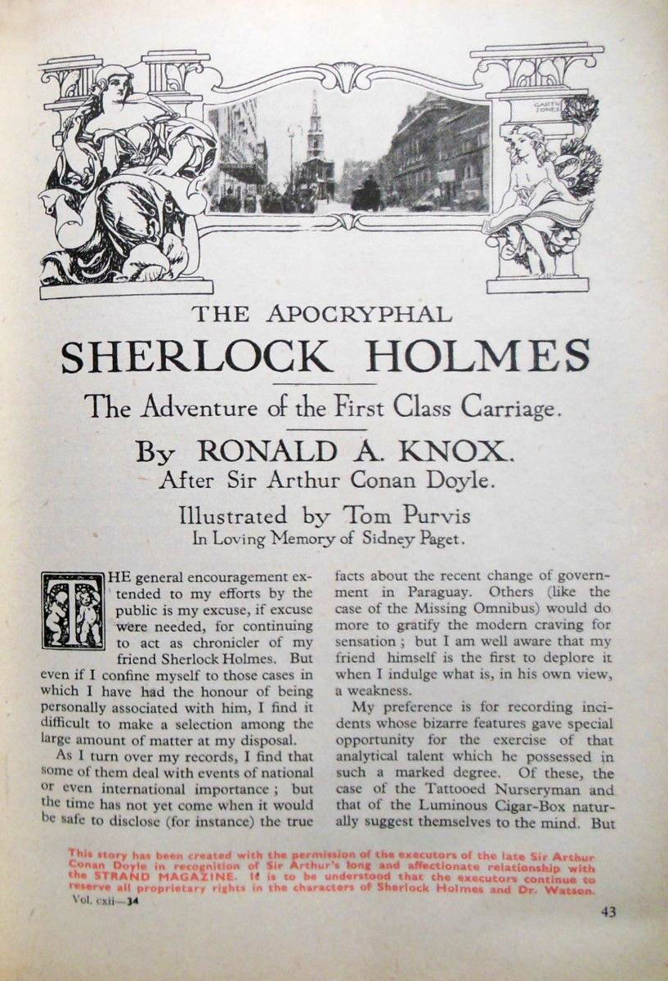
ANNE JAMISON | UNIVERSITY OF UTAH | FANFICTION AND ADAPTATION
Knox is a Watsonian
Knox was joking, but he is a huge Sherlock Holmes fan. He thinks it’s funny to devote this much critical attention to something as lowly as a detective story, but he also clearly goes on to devote this much attention to something so silly as detective stories. (He later wrote a number of them. He also became a priest.)
The treatment of Watson as a real person and actual author is also taken up by the Holmes fandom, or at least part of it. Doylists argue as if Doyle wrote the stories. Watsonians argue as if Watson wrote the stories, and Doyle was his agent.
This Holmesian explanations of canonical inconsistencies is if the stories are real is what Sherlockians referred to as “The Grand Game”; Sherlockiana; “The Great Game,” etc.
Knox goes on to write Sherlock Holmes fanfic pastiche, which he calls “apocryphal.”
[
Source: Studies in the Literature of Sherlock Holmes
Source: The Sherlock Holmes Encyclopedia

