Slide 1
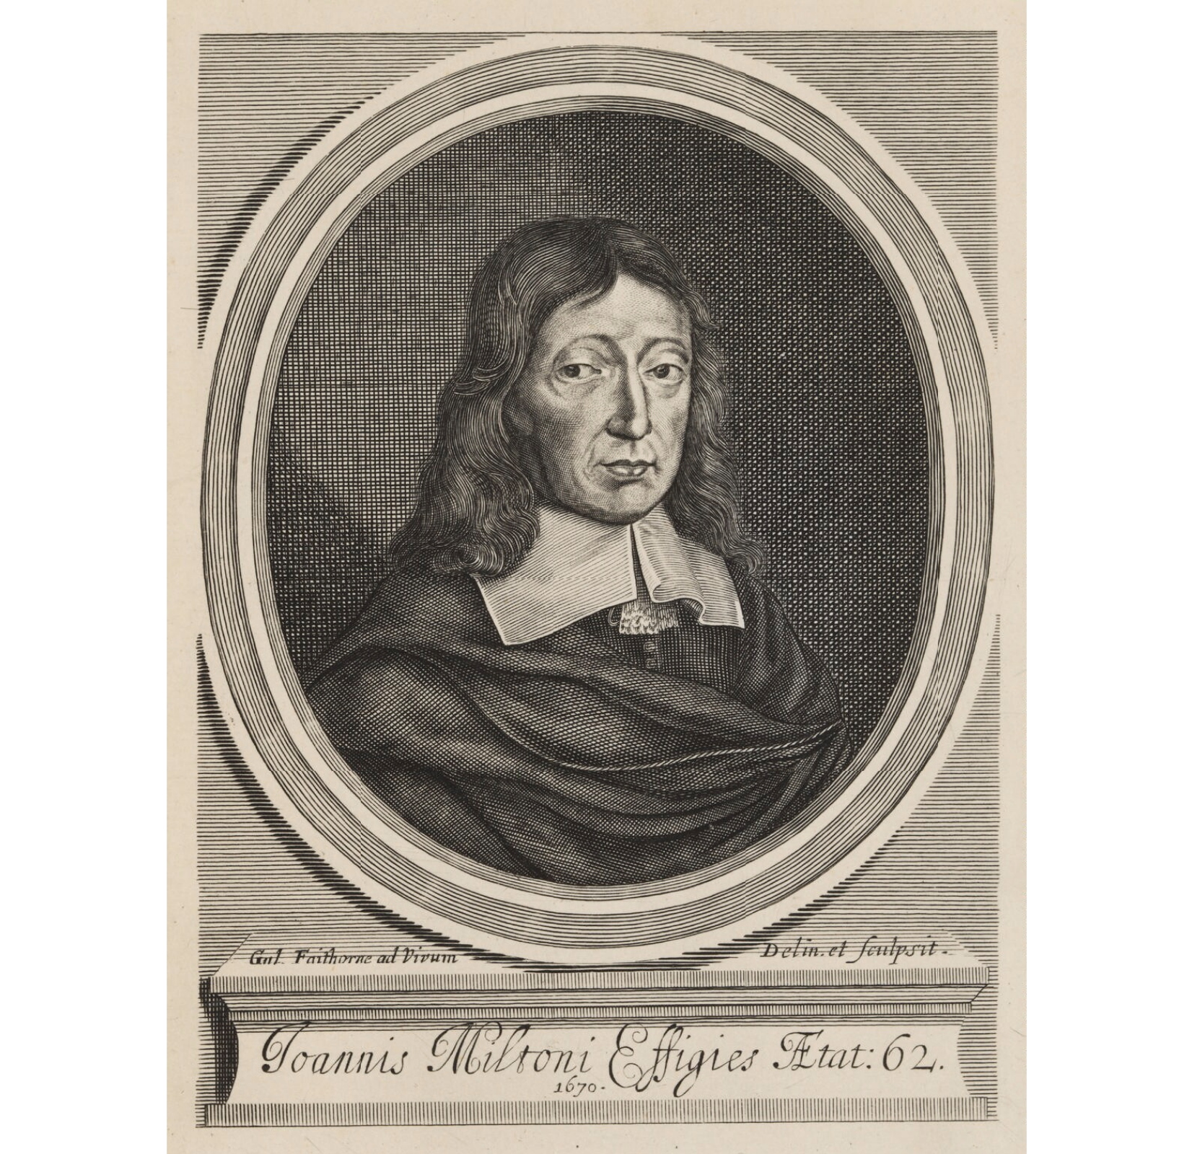
ANNE JAMISON | UNIVERSITY OF UTAH | FANFICTION AND ADAPTATION
John Milton, fanfic writer?
01

Slide 2
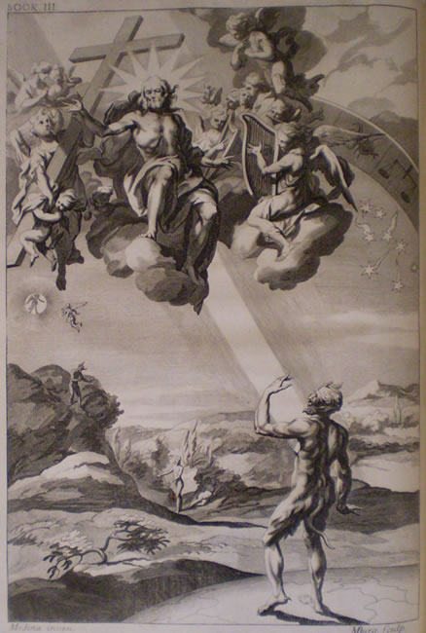
ANNE JAMISON | UNIVERSITY OF UTAH | FANFICTION AND ADAPTATION
So did John Milton write Bible fanfic?
Well, yes and no…
02
Illustration to the 1688 edition of Paradise Lost

Slide 3
ANNE JAMISON | UNIVERSITY OF UTAH | FANFICTION AND ADAPTATION
Yes, Paradise Lost is fanfic…
in that John Milton
took a widely known and beloved source (the Book of Genesis) with an active fanbase (Christianity)
rewrote it to give his own interpretation of the original (“justify the ways of God to Man”).
added more detail and backstory (and a lot more blank verse)
made the villain of the original source sexier and more sympathetic (Leather Pants Lucifer, basically).
He also inspired a ton of fan art.
That’s all pretty ficcish.
03

Slide 4
ANNE JAMISON | UNIVERSITY OF UTAH | FANFICTION AND ADAPTATION
But also no….
Paradise Lost isn’t fanfic in that no one was writing fanfic in the 17th century, because the media, legal and economic frameworks that make some works “fanfic” and others “official canon” didn’t exist yet.*
* They were on their way, though, and Milton played a key role.
03

Slide 5
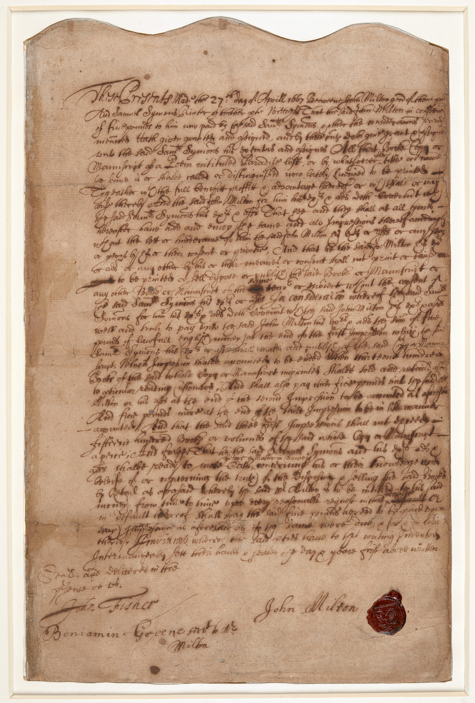
ANNE JAMISON | UNIVERSITY OF UTAH | FANFICTION AND ADAPTATION
Wait, Milton played a key role in what now?
As print technology improved, paper became more plentiful (though still expensive), and literacy rates began to improve, it became more feasible and more potentially profitable to make money by selling copies of books. Before the first copyright law (Statute of Anne, 1709), Milton sold the publishing rights to Paradise Lost to a publisher, and this contract is the very first contract between an English author and publisher that has survived. So, in the sense that copyright and ”official” publishing is key to the contemporary understanding of authorship, Milton (or his contract) is an important part of that history.
Milton sold the rights to the printer Samuel Symmons for £5 (about £840 or $1200 today) with another £5 to be paid after the first 1300 copies.
Source: The British Library

Slide 6
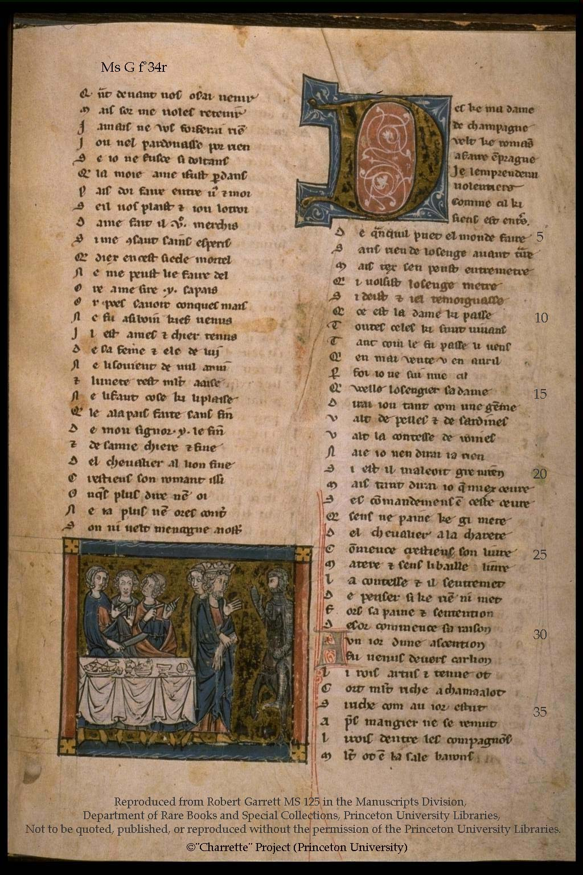
ANNE JAMISON | UNIVERSITY OF UTAH | FANFICTION AND ADAPTATION
When every book had to be copied by hand, and hardly anyone could write, selling 1300 copies of any book would have been a laughable idea.
Chrétien de Troyes didn’t make money by selling copies of his Arthur retellings and there was no original author or document to credit.
Ingnuity
Internal motivation
Inclusion
First page of Chrétien’s Knight of the Cart
Source: Princeton Charette Project

Slide 7
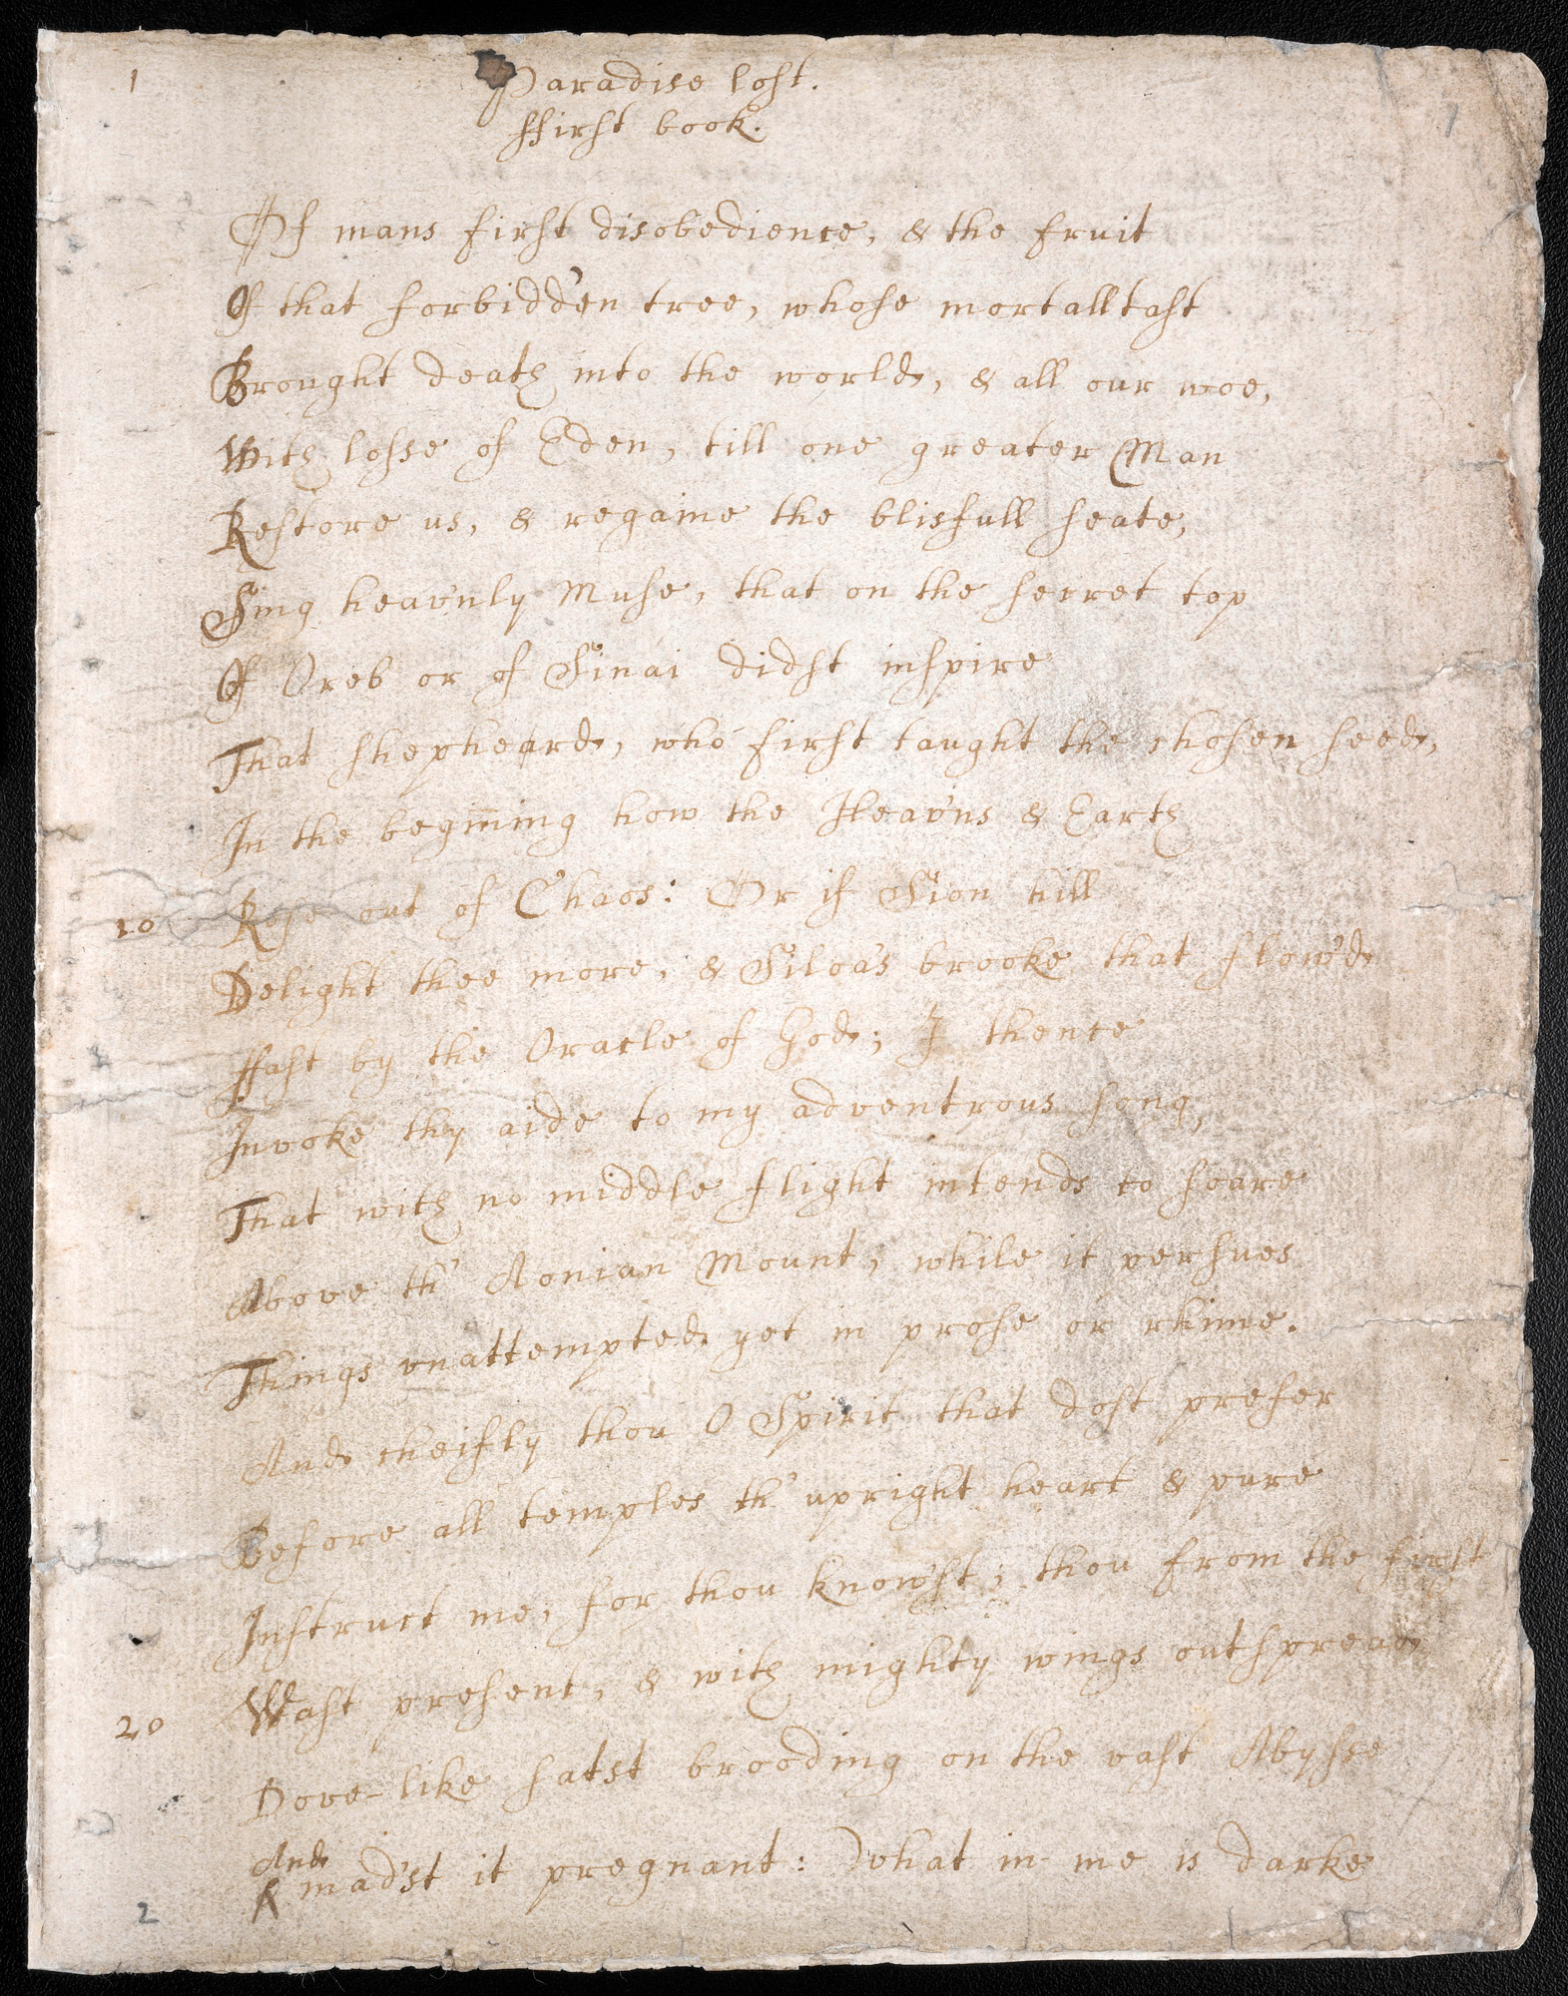
ANNE JAMISON | UNIVERSITY OF UTAH | FANFICTION AND ADAPTATION
Things were different by the 1760s, but writing was still quite a chore, in that any copy of a manuscript had to be recopied by hand to make a clean or “fair” copy to get to the printer. In Milton’s case, this process was significantly complicated because he was blind. So to write Paradise Lost, he composed in his head, memorized the lines, and then dictated them to a scribe.
All in all, quite different from typing ina story pushing a “post” button on a website.
This is the only extant manuscript of any of Paradise Lost.
Source: The British Library.

Slide 8
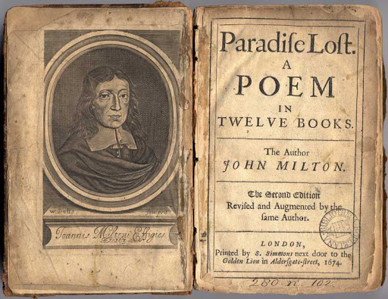
ANNE JAMISON | UNIVERSITY OF UTAH | FANFICTION AND ADAPTATION
[
Milton’s book did get more than one edition, though

Slide 9
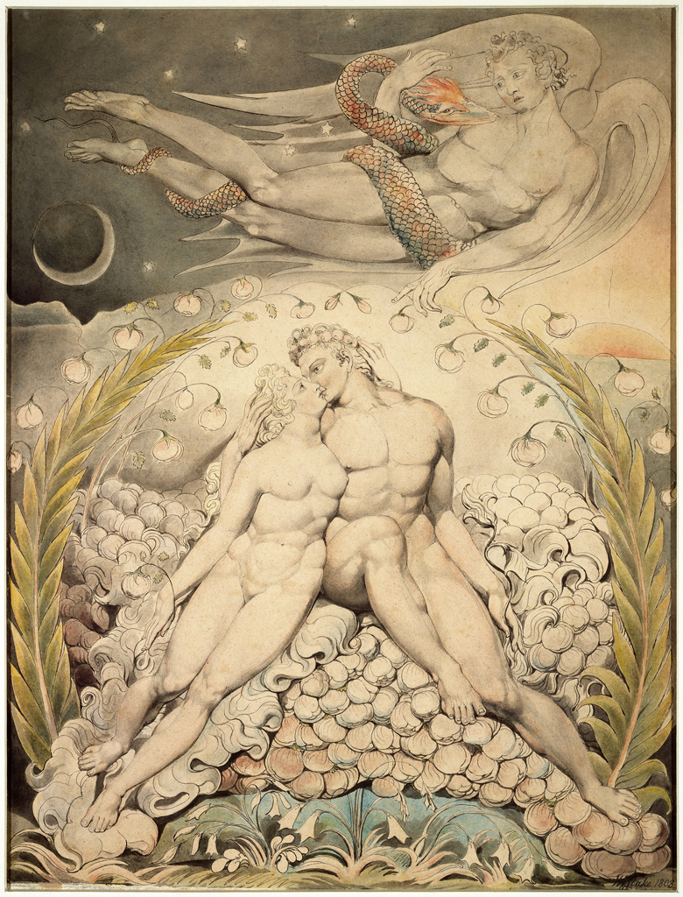
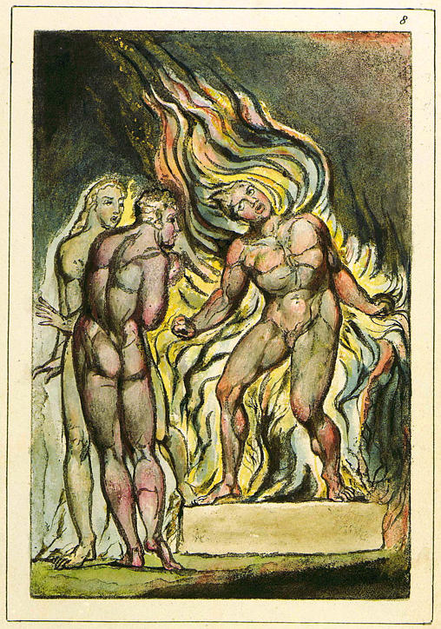
ANNE JAMISON | UNIVERSITY OF UTAH | FANFICTION AND ADAPTATION
William Blake, illustrations for Paradise Lost
William Blake, Illusttration from Milton
That said, Milton has certainly inspired some world-class fan art, like this from Big Name Fan William Blake, often credited as the originator of the “Milton was in the devil’s camp without knowing it,” trope, now established fanon.
←Blake’s illustrations of Paradise Lost continue in the fine ficcish tradition of sexing up the source, adding voyeurism, six-pack abs, arguable auto-erotica (Snake/Satan), a love triangle, possible poly/OT3 if you squint, and a sexy snek. In other words, typical Blake.
Blake also operates in the DIY fannish tradition, developing innovative ways of using existing technology to create and distribute his hand-written and hand-drawn books, like the fanzine precursor Milton.→
[
Satan watching the Caresses of Adam and Eve (Book 4, l. 492)
Source: British Library
Source: The Blake ARchive

Slide 10
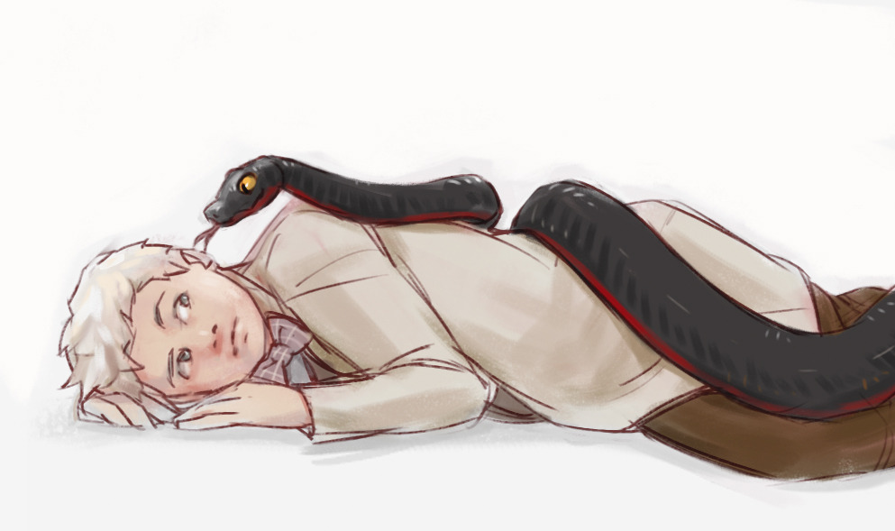
ANNE JAMISON | UNIVERSITY OF UTAH | FANFICTION AND ADAPTATION
Neither Milton rewrites nor nor sexy snake of eden fan art (nor cuddly snake of eden fan art, as here) have diminished in popularity….
art by tumblr user Tio-Trile

